Slide 1
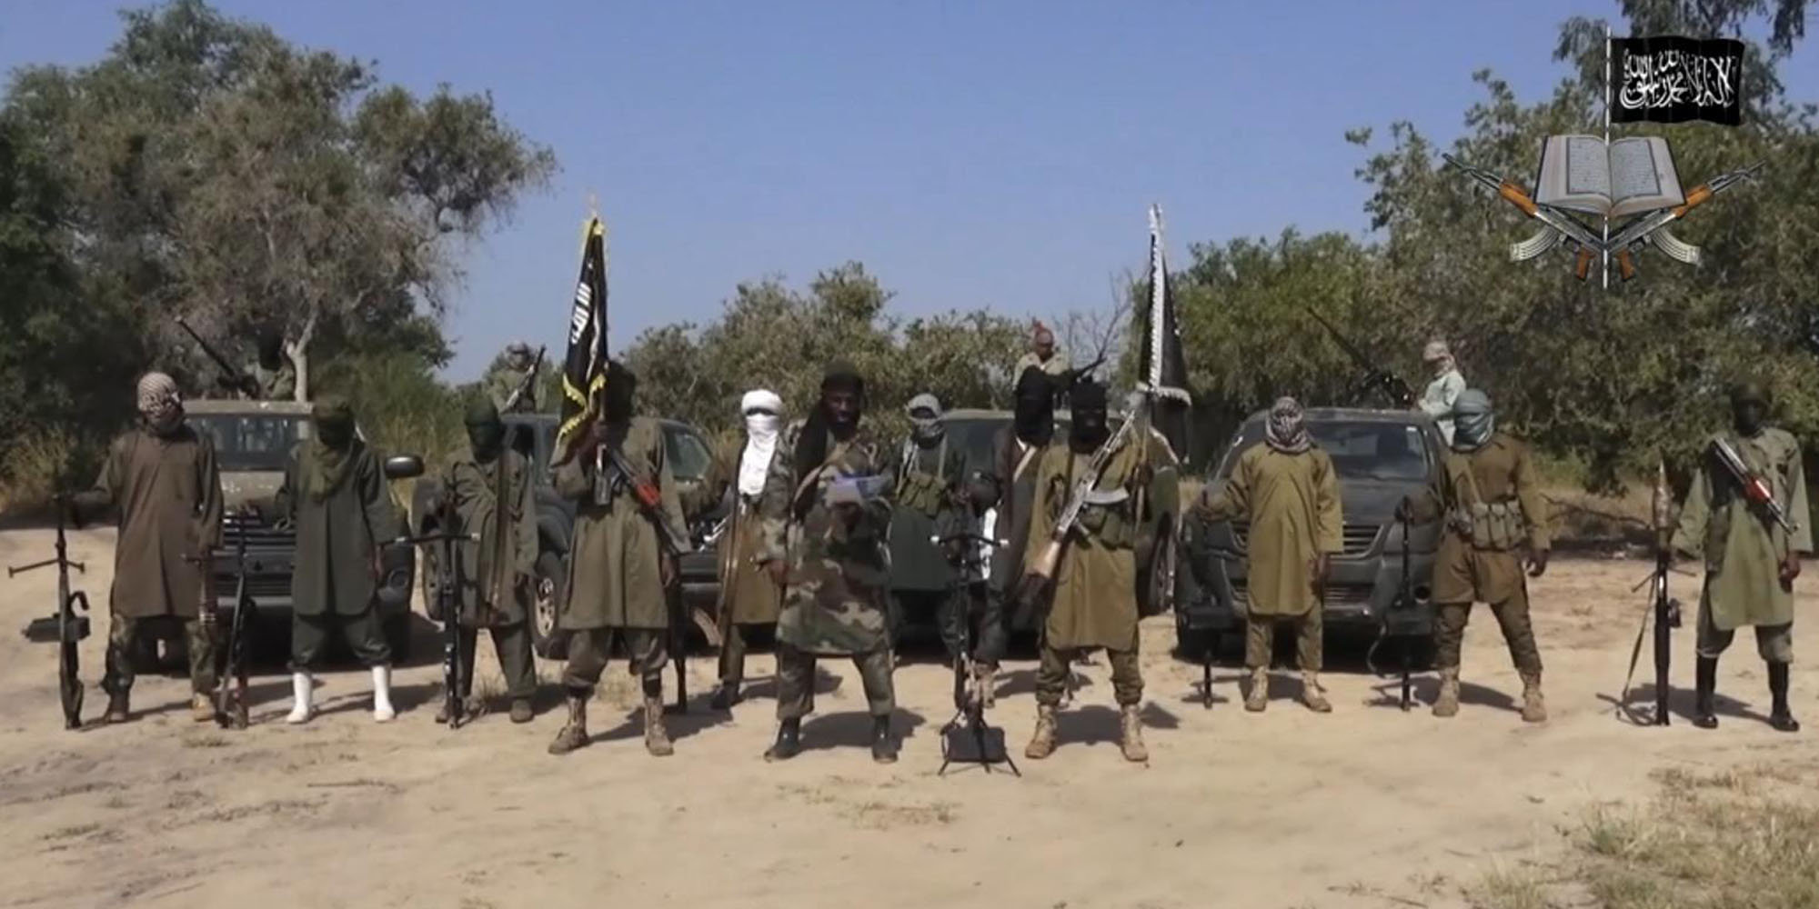
Boko haram and Nigeria’s paradox: Winning the battles but losing the war
Justin Crocker
September 8, 2016

Slide 2
Outline of discussion
Nigeria prior to Boko Haram
Boko Haram’s emergence
Boko Haram 2010-2015
President Buhari’s election and Boko Haram since 2015
The current landscape of Boko Haram and northern Nigeria

Slide 3
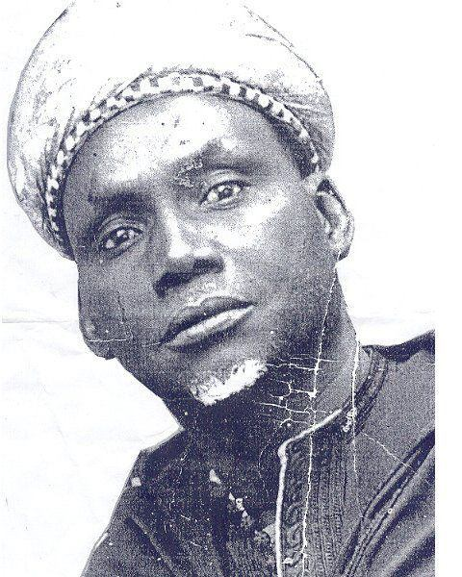
Nigeria prior to boko haram
The introduction of Islam to Nigeria, Dan Fodio and the Sokoto Caliphate
British colonialization of Nigeria
The amalgamation of Nigeria
The Niger Delta, oil and the resource curse
Underdevelopment, unemployment and poverty in Nigeria
Why is Nigeria getting richer while Nigerians are getting poorer?

Slide 4
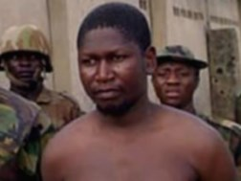
The emergence of boko haram
Mohammad Yusuf and rising Islamic fundamentalism in the LCB
Ibn Taimiyyah Masijid in Maiduguri
“Boko Haram”, “Nigerian Taliban”
July 2009 and Yusuf’s extrajudicial killing

Slide 5
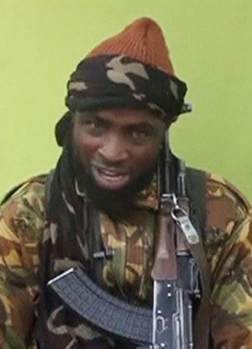
Boko haram 2010-2015
Abubakar Shekau and Boko Haram’s reemergence in 2010
Boko Haram’s expansion
Nigeria’s initial response to Boko Haram
Human rights abuse allegations
The Chibok girls, terror lists and Nigeria’s politicization of Boko Haram
Formal allegiance to the Islamic State (January 2015)

Slide 6
What is Boko Haram’s ultimate objective?
Taken from an open letter from Abubakar Shekau to the Nigerian government in August 2011:
“The reasons [for our attacks] are clear: 1. The Nigerian government is a kufur (infidel) system serving both [the] United Nations and [the] Christian Association of Nigeria (CAN); 2. We, the Jama’atu Ahlisunnah Lidda’awati Wal-Jihad are Muslims and are from the Northern part of the country who spent eight years agitating for Islamic State, striving to bring back to the ways of our creator where justice, discipline, good morals, love and care, peace and progress etc. will prevail.”

Slide 7
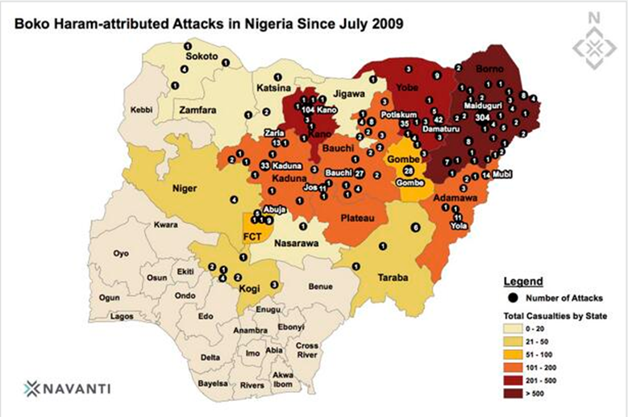
President buhari’s election and book haram since 2015
President Buhari’s reinvigorated counter-Boko Haram efforts since May 2015
The current landscape of Boko Haram and Northeast Nigeria
Boko Haram’s reduced footprint in Borno
Expansion efforts into Niger and Cameroon?
Emerging humanitarian crisis
Middle belt conflict: adding to potential Boko Haram recruits?
Operation Safe Corridor
Whole-of-government approach to defeating Boko Haram
Boko Haram reemergence?
Split within Boko Haram; influences from Ansaru and AQIM

Slide 8
Operation safe corridor
Developed in 2013 as Nigeria’s DDR program
Designed as a 12-week program; religious de-radicalization & vocational trianing
Approximately 1000 surrendered militants are currently in the program
Located in Giwa Barracks, Maiduguri
Potential problems with OSC
Doesn’t address local grievances & desires of revenge
Legal status of surrendered combatants
How are conscripts treated? Child soldiers?
No defined process for determining whether a former militant is rehabilitated
Focused on religious de-radicalization; may be ignoring underlying causes of insurgency

Slide 9
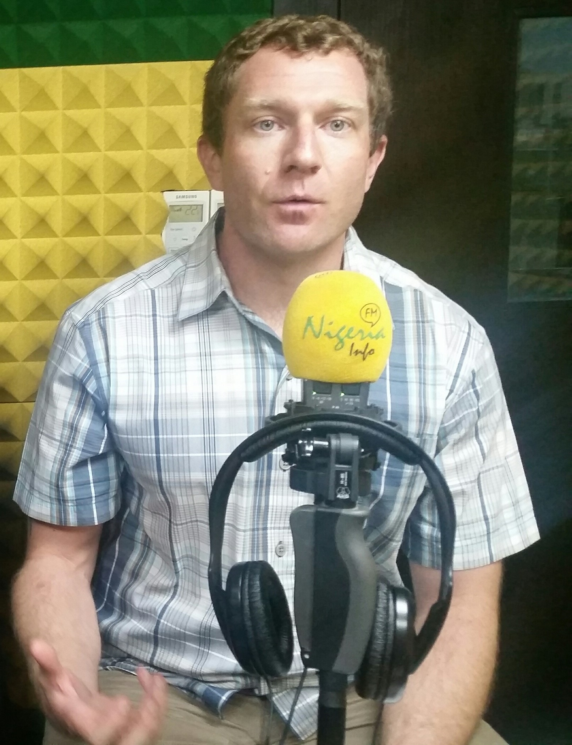
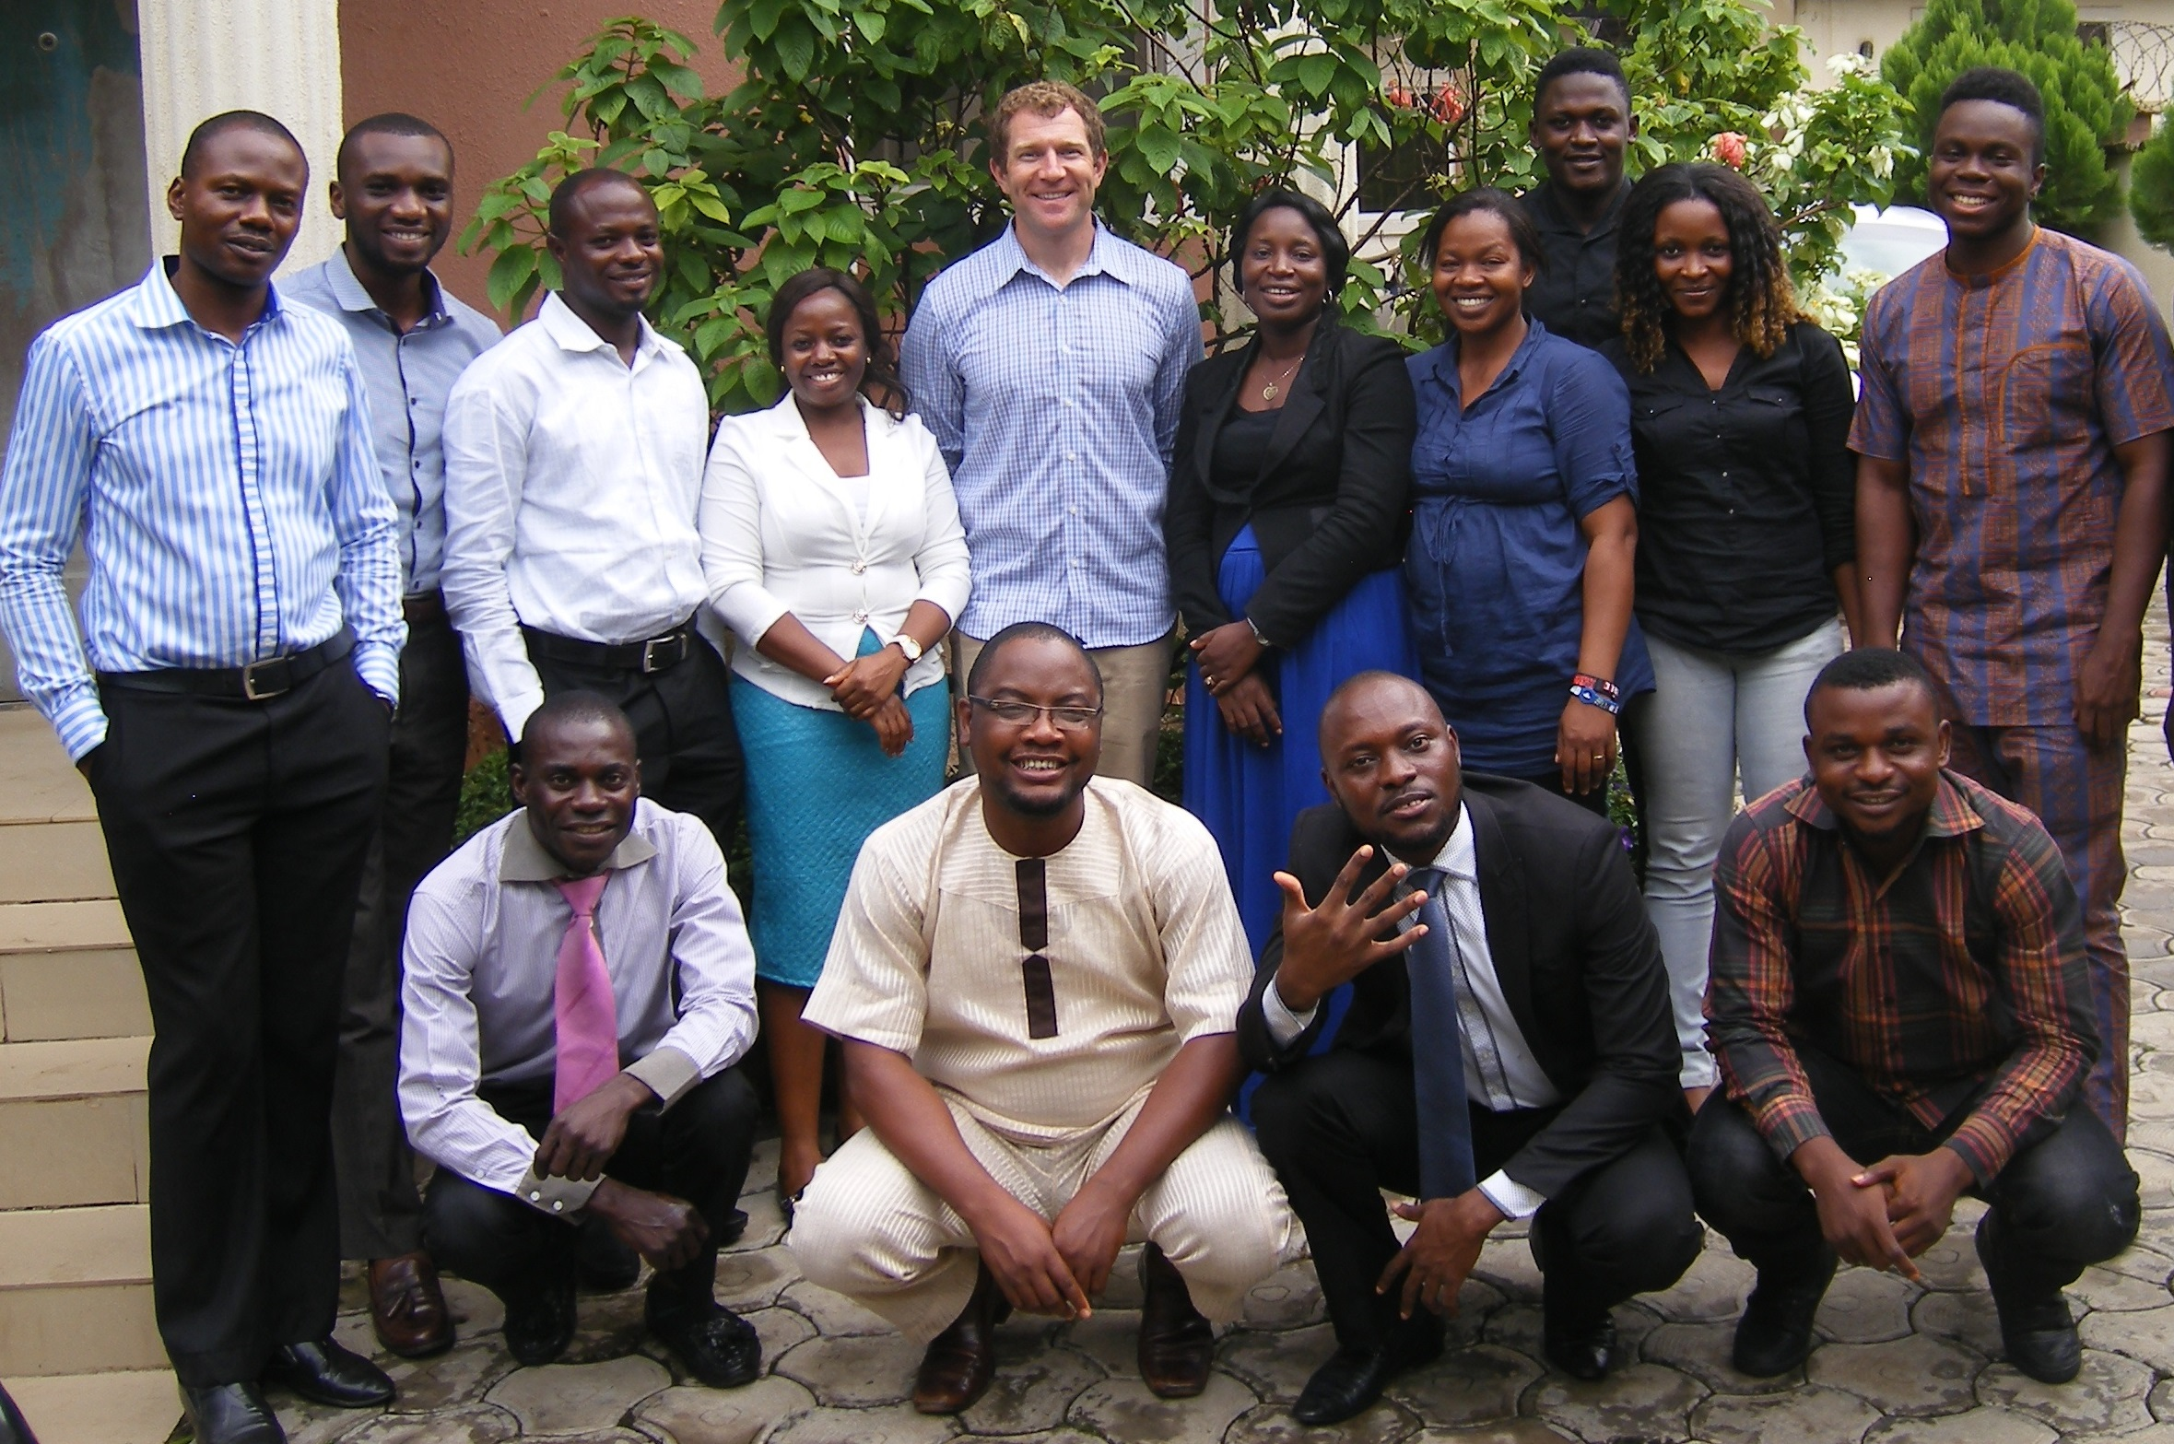
The only pictures of me in Nigeria

